Slide 1

Web scraping CUSTOMER REVIEWS to gain company insights
13/05/2024

Slide 2
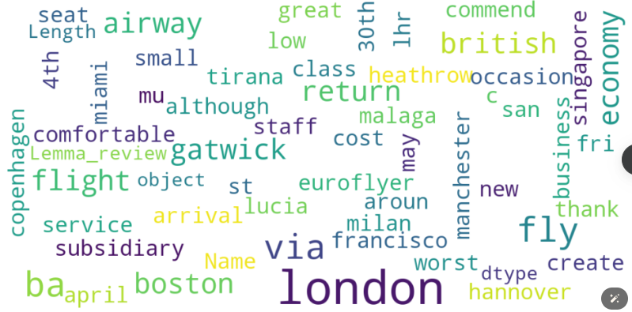
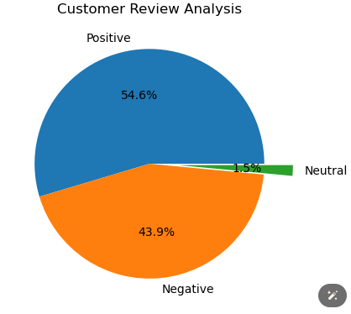
INSIGHTS GOTTEN FROM CUSTOMER REVIEWS
Notes:
- 800 Customer reviews were analyzed and this results were obtained Positive reviews- 437, Negative reviews – 351, Neutral reviews – 12. -Also keywords from overall customer review was gotten during analysis from WordCloud to highlight areas complaints and compliments.

Slide 3
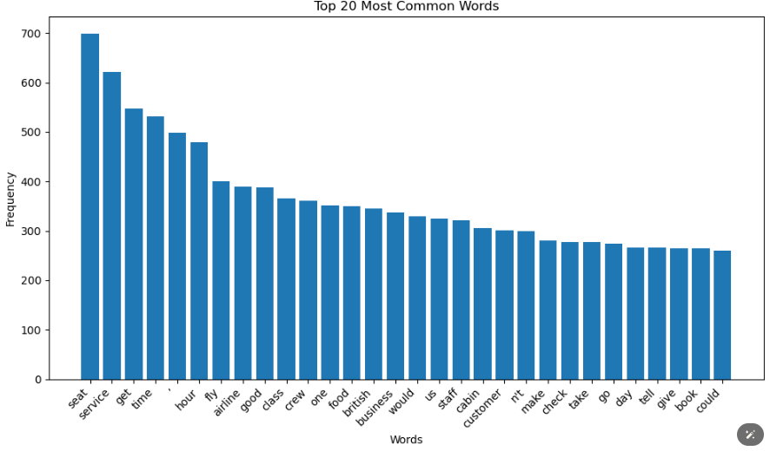
INSIGHTS GOTTEN FROM CUSTOMER REVIEWS
Notes:
- Common words used in reviews

Slide 4
RECOMMENDATIONS
Focus On – Economy class service, like the Food, Seats and especially Delays.

